Slide 1
Graphing
The relationship between two variables can often be determined by organizing experimental data into a graph.

Slide 2
Variables
Independent variable
- the value that the experimenter chooses to vary (changes on purpose)
- usually plotted on the horizontal axis
Dependent variable
- the value that changes in response to the variation in the independent variable (changes accordingly)
- usually plotted on the vertical axis

Slide 3
Key Steps to Constructing a Graph from Experimental Data
1. Give the graph a TITLE
tell what it is about (Position vs. Time, Pressure vs. Volume, etc.)
2. Draw two axes for the variables
make the graph large enough to occupy the full piece of paper, but indent the axes from edges of paper for labeling.
3. Label the axis
with names of the variable (temperature, mass, volume, etc.) AND the proper units (ºC, gram, mL, etc.)

Slide 4
Constructing a Graph, cont’d
4. Choose a range for each variable that includes all the data
sometimes it is helpful to start both axes from zero.
5. Divide the range of each axis into even divisions with markings.
6. Mark the spot for each data point on the graph

Slide 5
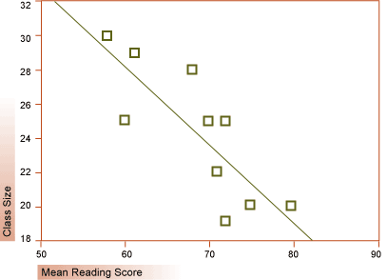
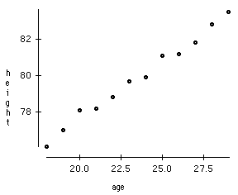
Best-fit Line for Linear Trend
If the data points show a linear trend, a best-fit line can be drawn

Slide 6
Drawing Best-Fit Line
Best-fit line IS a single, straight line.
Best-fit line should pass through as many points as possible but with other points evenly distributed along both sides of the line.
Best-fit line does NOT mean connect the dots
Best-fit line does NOT have to pass through the origin

Slide 7
Slope of a Line
run = value change in the independent variable
rise = corresponding change in the dependent variable
What does slope tell us?
Slope is the rate of change. In other words, rate shows how fast the dependent variable changes in response to the change in the independent variable.

Slide 8
Determine Slope of the Best-fit Line
To obtain ∆y and ∆x, coordinates of two points on the line are needed.
Guidelines for choosing two points to calculate slope
- both points have to be on the line
- neither points can be data points
- the two points should be far from each other
- both points have to be within data range (between the lowest and the highest data points)
This is to minimize additional uncertainty introduced through calculation.

Slide 9
Y-intercept of the Best-fit Line
Y-intercept of a line is the value of the dependent variable when the line intercepts with the vertical axis.
In other words, y-intercept is the value of y when x = 0.
Determine y-intercept of the best-fit line
Extend the best-fit line to cross the vertical axis where x=0
Estimate the value of y at the crossing point.

Slide 10
Representing a Line with Mathematical Equation
Slope Intercept Form
y = mx + b
where,
y and x should be substituted by names of the dependent variable and the independent variable, respectively
m is Slope
b is y-intercept
Example:
position = (3.5 m/s) x time + 1.0 m
pressure = (2.8 mmHg/°C) x temperature + 704 mmHg

Slide 11
Variable vs. Constant
A VARIABLE changes in value.
A CONSTANT does not change…. It is CONSTANT!
In the equation
position = (3.5 m/s) x time + 1.0 m
Position and time are variables.
The slope 3.5 m/s and y-intercept 1.0 m are constant.
Constants always have units after the numerical value.
Variables already have units included in their names.

